Slide 1
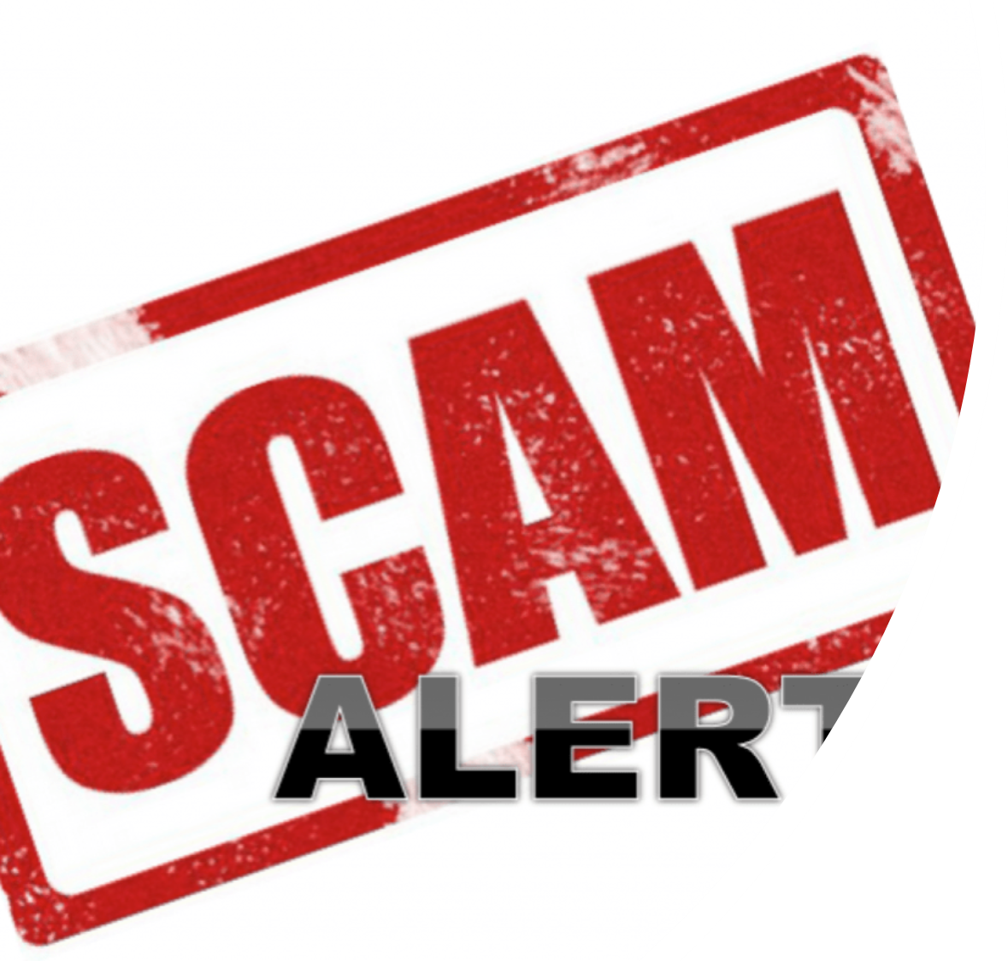
Is it Safe or Is It a Scam?
This Photo by Unknown Author is licensed under CC BY-NC
Notes:
Is it Safe or Is It a Scam?

Slide 2
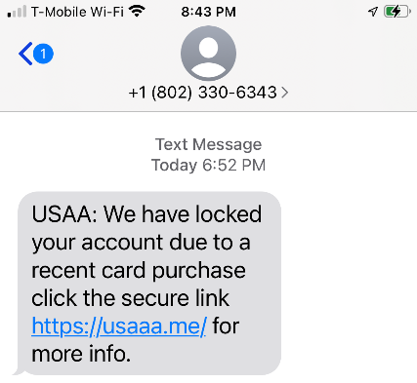
John’s email
John gets a text message from USAA that says his account is locked. It tells him to click on a link for more information. Is it safe or is it a scam? What should he do?
Notes:
This is a scam. Delete the email. If students need help, ask them to look at the name of the company – USAA, and the link, usaaa.me.

Slide 3
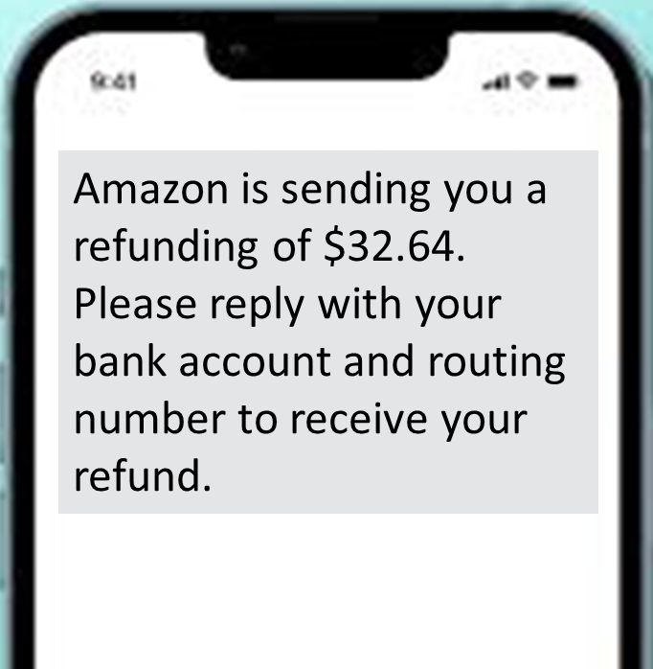
Cati’s text message
Cati gets a text message from Amazon that says she has a refund. The message says she needs to reply with her bank account and routing number. Is it safe or is it a scam? What should she do?
Notes:
This is a scam. Delete the message. Students should never reply to a text or email with their bank account and routing number.

Slide 4
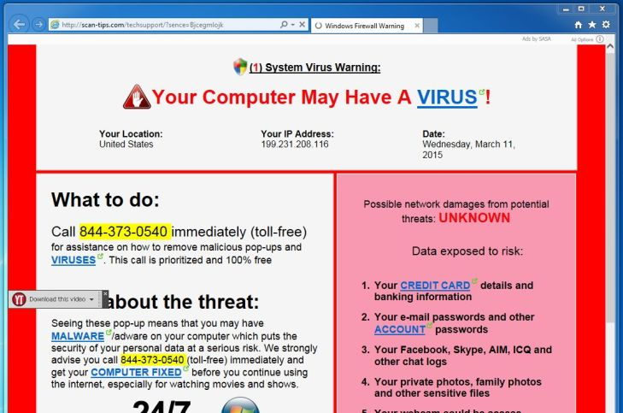
Tony’s pop-up window
Tony is on a web page when a pop-up window says that his computer is infected. Is it safe or is it a scam? What should he do?
Notes:
This is a scam.
First of all, Tony should NOT click on the pop-up window.
Tony should first try to close Google Chrome. If he cannot close Google Chrome, he should press down the power button on her computer until it shuts off and then turn it back on. Finally. Tony should not go back to the masterofkeeps.xyz website.
Tony can use Ctrl-Alt-Del and then click on the Power Icon to shut down or restart his computer.

Slide 5
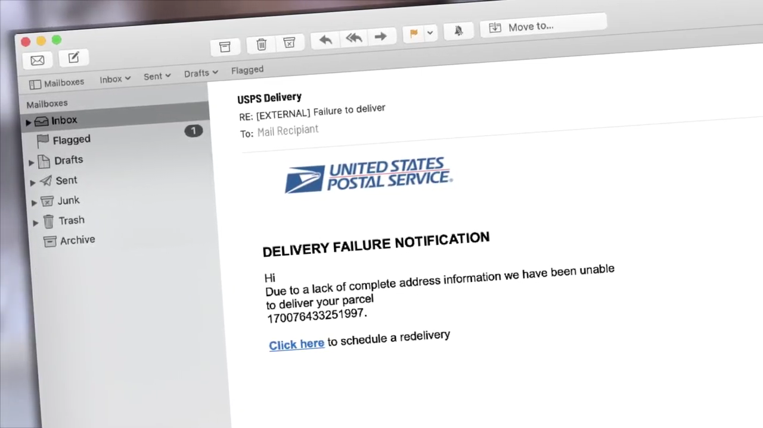
David’s email
David gets an email on his computer from the United States Postal Service. It asks him to click on a link to schedule a delivery. Is it safe or is it a scam? What should he do?
Notes:
This is a scam. Delete the email. The Postal Service does not notify customers about package delivery attempts by email.
The USPS has a 1-minute video about scams that use the name of USPS on YouTube: https://www.youtube.com/watch?v=Ksfyr7wZhhE. You can slow the video down to play it for students who are more advanced. Also, you can auto-translate the video into many languages by going to the YouTube Settings icon, clicking on Subtitles/CC, and then clicking on Auto-translate.

Slide 6
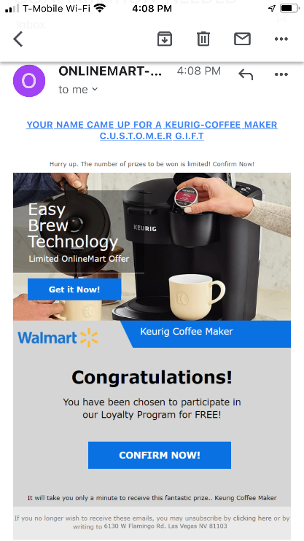
Mark’s email
Mark gets an email that he needs to confirm his gift immediately. The email looks like it is from Walmart. Is it safe or is it a scam? What should he do?
Notes:
This is a scam. Delete the email. This email offers a prize, which is almost always a scam. The email shows that the sender is ONLINEMART, not Walmart.

Slide 7
Sarah’s text message
Your Amazon account has been locked because we’ve detected suspicious activity on your account. Recovery your account immediately by click link bellow: https://m.v.k.com/away.php?cheer=front&elite=level&to-https://mobile-manage-details-amazon-bunny20112.codeanyapp.com
Sarah gets a text message from Amazon about her account getting locked. The message asks her to click on a link. Is it safe or is it a scam? What should she do?
Notes:
This is a scam. Delete the message. There are several warning signs. First, it is something that must be done immediately. Second, the link does not go to the amazon website. Finally, there are mistakes in the English – the word recovery instead of recovery and the word below is misspelled (bellow).

Slide 8
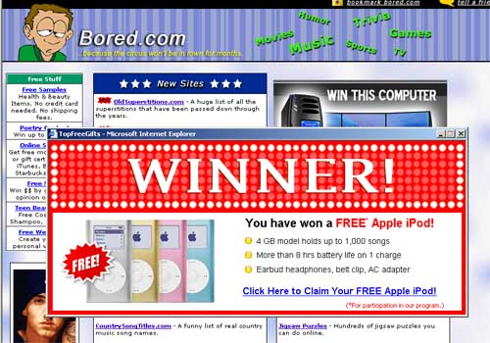
Barbara’s pop-up window
Barbara is on a web page. She gets a pop-up window telling her that she is a winner. Is this safe or is it a scam? What should she do?
Notes:
This is a scam.
First of all, Barbara should NOT click on the pop-up window.
Barbara should first try to close Google Chrome. If Barbara cannot close Google Chrome, she should press down the power button on her computer until it shuts off and then turn it back on. Finally. Barbara should not go back to the bored.com website.
Barbara can use Ctrl-Alt-Del and then click on the Power Icon to shut down or restart his computer.

